Slide 1
Time series
“The Art of Forecasting”

Slide 2
Economics: Sales, Stock Prices
Astro Physics: Star location, Intensity of star
Geophysics: Earthquakes

Slide 3
time series analysis is about inferring what has happened to a series of data points in the past and attempting to predict what will happen to it the future.

Slide 4
Basics for Time Series
Expectation
Variance
Standard Deviation
Covariance
Correlation

Slide 5

Basics For Time Series
Expectation E(x) = u
The expected value or expectation, E(x) of a random variable x is its mean average value in the population.
Variance
The variance of a random variable is the expectation of the squared deviations of the variable from the mean, denoted by σ²(x)=E[(x−μ)²]
Standard Deviation: Square Root of variance
The Covariance of random variable is?

Slide 6

Basics For Time Series
The Covariance of random variable is?
What is correlation?

Slide 7
Stationarity in Time Series
Correlogram
Mean
Variance
Mean of Time Series
In time series mean is function of time E(x) = u(t)
This expectation is taken across the ensemble population of all the possible time series that could have been generated under the time series model.

Slide 8

Stationarity
Stationarity in mean:
If Mean is constant over time then we say time series is stationary in mean
Variance of time series
Stationarity in the variance

Slide 9


Autocovariance
Correlation with time lag K
C_{k} is not function of time

Slide 10


Autocorrelation of time series
Autocovariance
Autocorrelation
For lag 0 or (k=0)

Slide 11
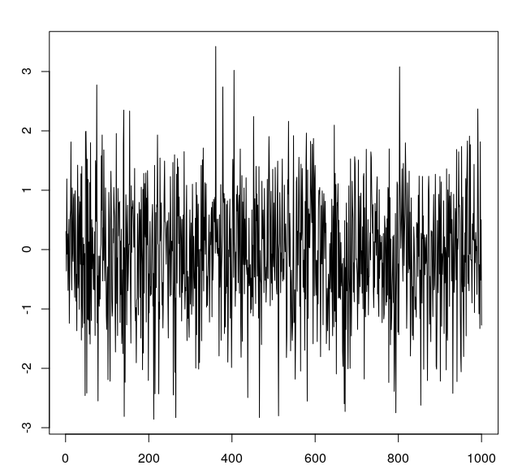
Time Series plot

Slide 12
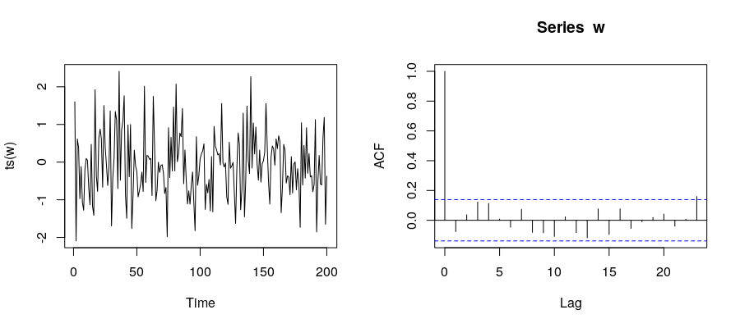
Correlogram

Slide 13
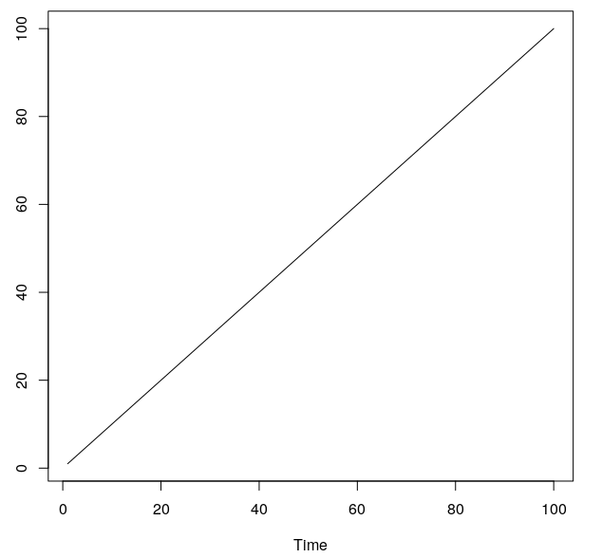
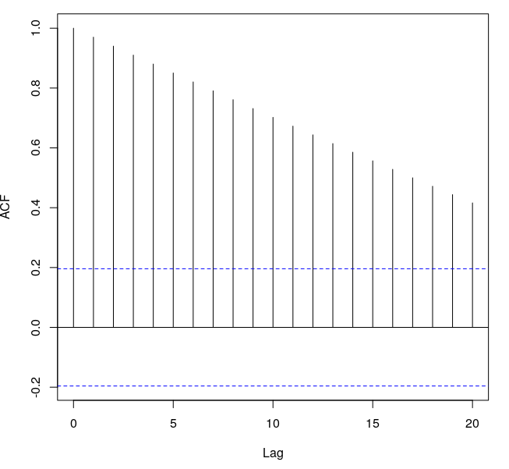
Correlogram

Slide 14
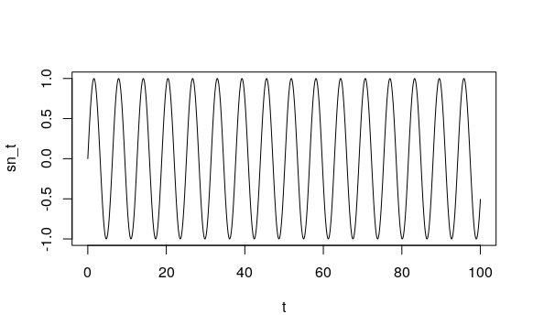
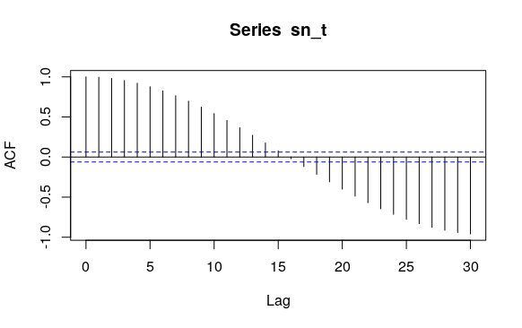
Correlogram

Slide 15
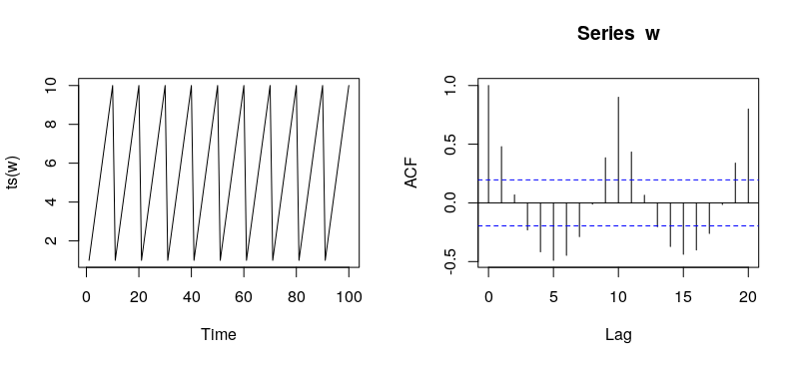
Correlogram

Slide 16
White Noise
N(0,sigma)

Slide 17
Backward Operator
B x_{t} = x_{t-1}
B²x_{t} = x_{t-2}
B^{n}x_{t} = x_{t-n}

Slide 18
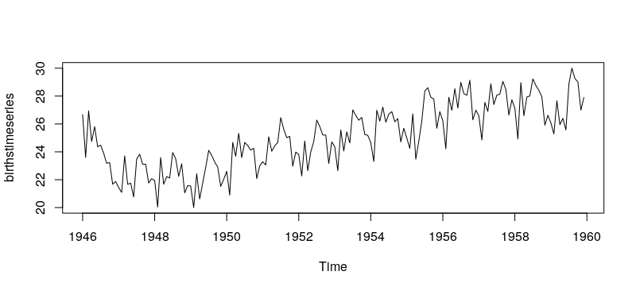
Time series components

Slide 19
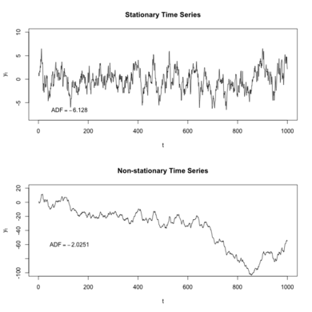
Trend
A trend is a smooth, general, long-term, average tendency. It is not always necessary that the increase or decrease is in the same direction throughout the given period of time.

Slide 20
Seasonal Variations

Slide 21
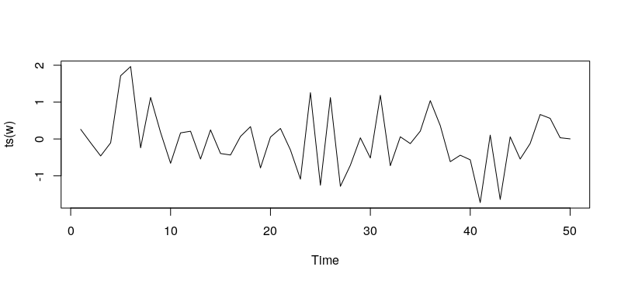
Noise

Slide 22
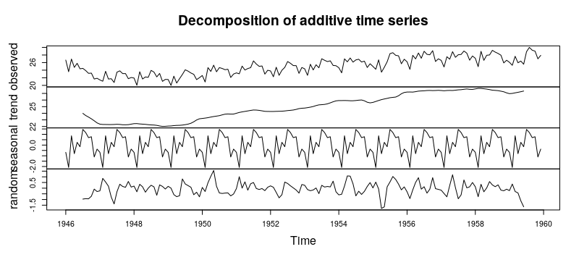
Combining time series models

Slide 23
Random Walk
A random walk is a time series model x_{t} such that x_{t}=x_{t−1}+w_{t} where wt is a discrete white noise series.
x_{t}=x_{t−1}+w_{t}
x_{t-1}= B x_{t-1}+w_{t-1}
X_{t} = (1+B+B²+....)w_{t}

Slide 24
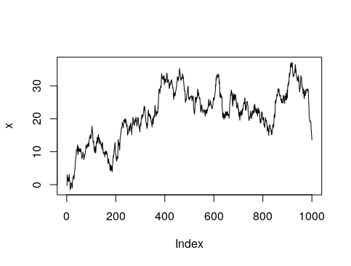
Random walk
x <- w <- rnorm(1000)
for (t in 2:1000) x[t] <- x[t-1] + w[t]
plot(x, type="l")

Slide 25
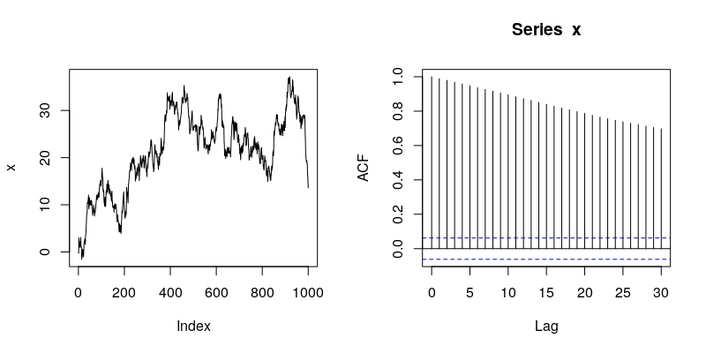
ACF plot of Random walk

Slide 26
How to subtract trend from Random walk?

Slide 27
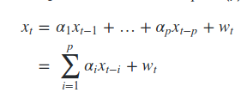
Autoregressive model AR(p)
We considered random walk where x_{t} is solely dependent on x_{t-1}
x_{t}=x_{t−1}+w_{t}
AR model is extension of random walk
The autoregressive model is simply an extension of the random walk that includes terms further back in time

Slide 28

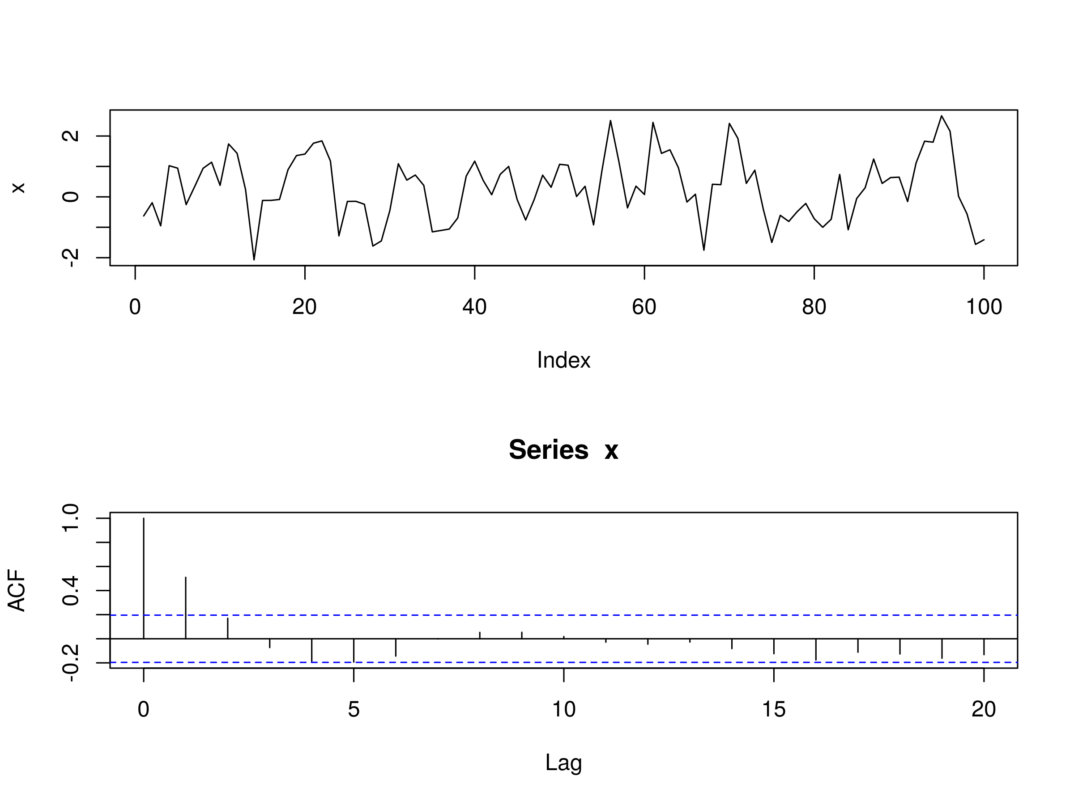
AR(1) process

Slide 29
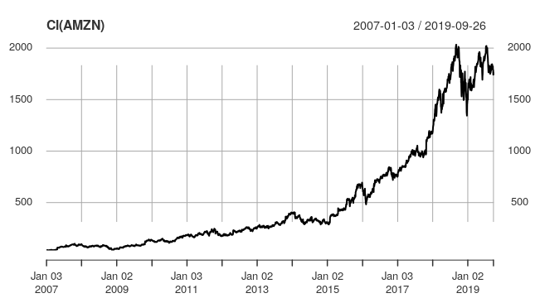
Amazon example

Slide 30
AR(p) model
AR(p) model is not always stationary
TO find order of model we can see that at k correlation value will be more than boundary
S&P example

Slide 31
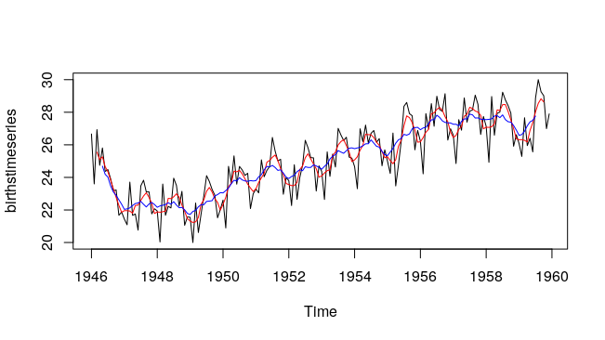
Simple Moving average

Slide 32


Moving average process MA(q)
Mathematically MA(q) is linear regression and is similar structured like AR(p)
W_{t} is white noise
E(W_{t}) = 0
var(w_{t})= sigma

Slide 33
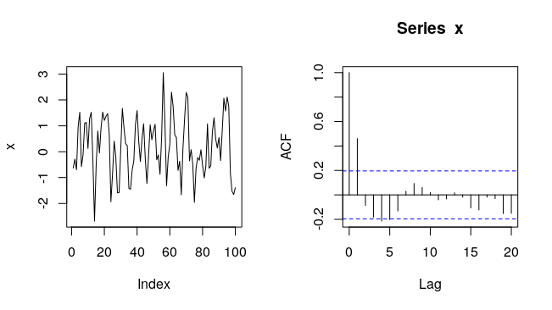
Moving average MA(1)

Slide 34
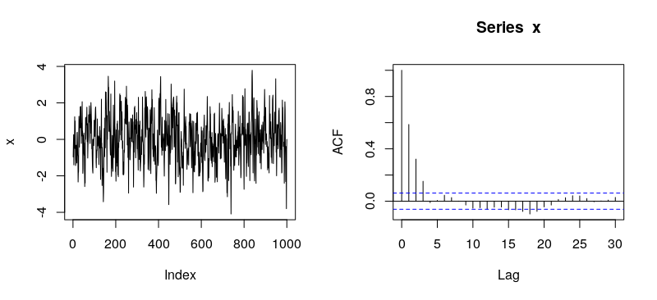
MA(3)

Slide 35
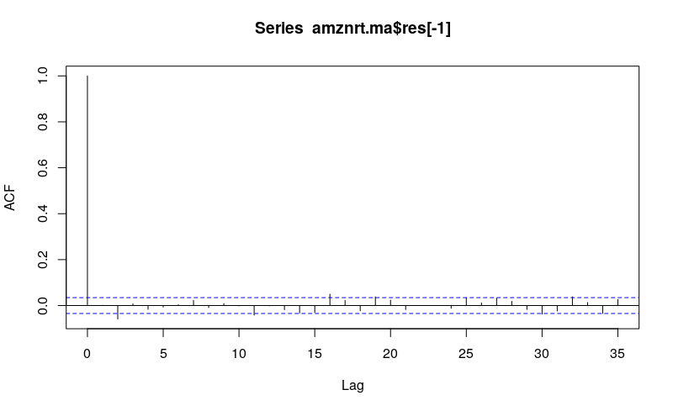
MA(1) Amazon stock

Slide 36
Autoregressive Moving average process ARMA(p,q)
The ARMA(p,q) model is a linear combination of two linear models and thus is itself still linear
W_{t} is white noise
E(W_{t}) = 0
var(w_{t})= sigma

Slide 37
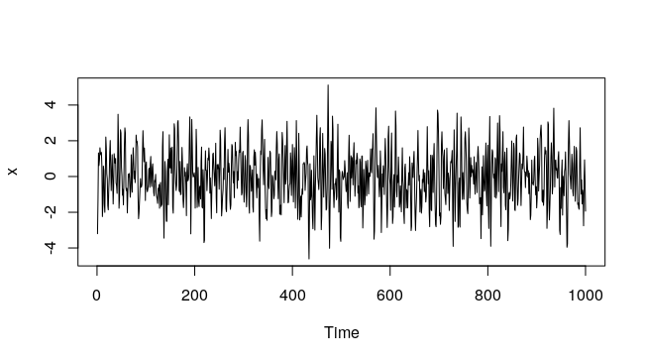
ARMA(2,2)

Slide 38
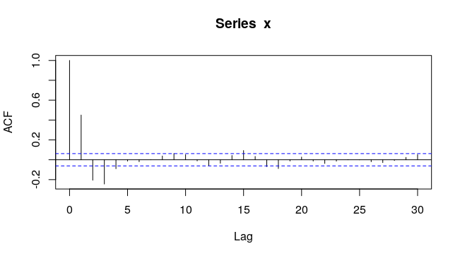
ARMA(2,2)

Slide 39

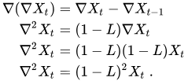
Difference Operator

Slide 40
Autoregressive Integrated Moving Average (ARIMA) Models of order p, d, q
ARIMA models are used because they can reduce a non-stationary series to a stationary series using a sequence of differencing steps.
If we apply difference operator to random walk what remains is just white noise
X_{t} - X_{t-1} = w_{t}
ARIMA essentially performs this function, but does so repeatedly, d times, in order to reduce a non-stationary series to a stationary one.
Seasonality effects (such as those that occur in commodity prices) can be tackled with the Seasonal ARIMA model (SARIMA), however we won't be discussing SARIMA much in this series.

Slide 41

Integrated series of order d
That is, if we difference the series d times we receive a discrete white noise series.

Slide 42
ARIMA p,d,q
A time series {x_{t}} is an autoregressive integrated moving average model of order p, d, q, ARIMA(p,d,q), if ∇^{d}x_{t}
is an autoregressive moving average of order p,q, ARMA(p,q).
That is, if the series {xt} is differenced d times, and it then follows an ARMA(p,q) process, then it is an ARIMA(p,d,q) series.

Slide 43
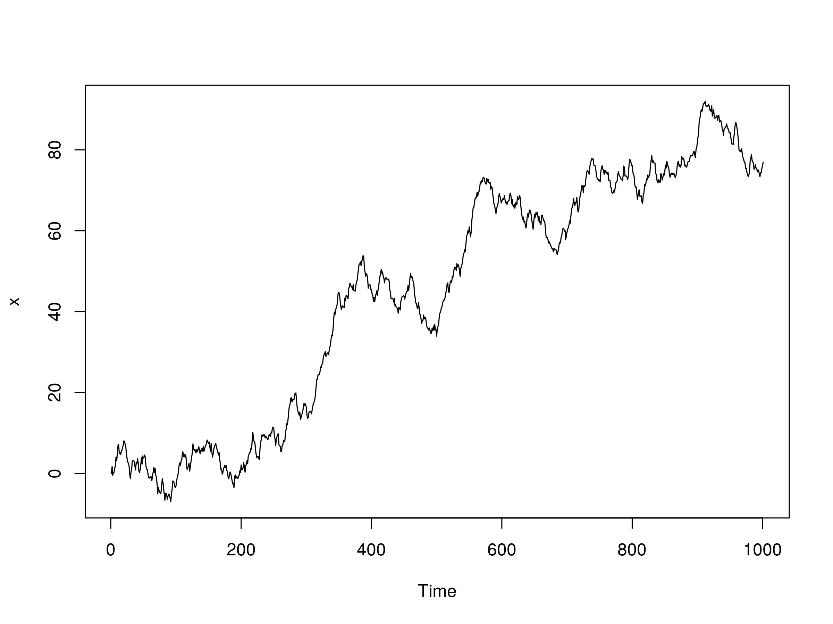
ARIMA p,d,q

Slide 44
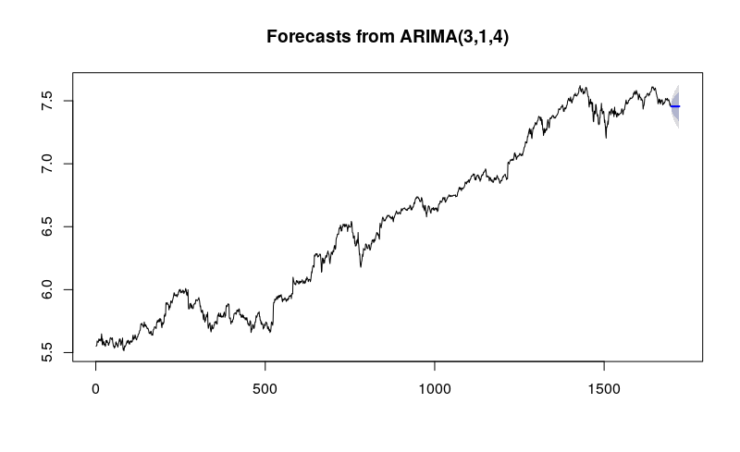
Amazon stock price forecast

